Slide 1
Java 4 WEB
Lesson 18 – Spring Jdbc

Slide 2
Lesson goals
Spring JdbcTemplate overview

Slide 3
Spring JdbcTemplate. Advantages
More convenient work with the database
Automatic release of resources
Transformation of exceptional situations of the DB into software
Flexible data access interface

Slide 4
Spring JdbcTemplate. Disadvantages
Some very specific logic can be implement only on low level (using connections and statements)
JdbcTemplate methods that work with class BeanPropertyRowMapper are slow because of reflection (on of previous version of JdbcTemplate had a performance issue with functionality)

Slide 5
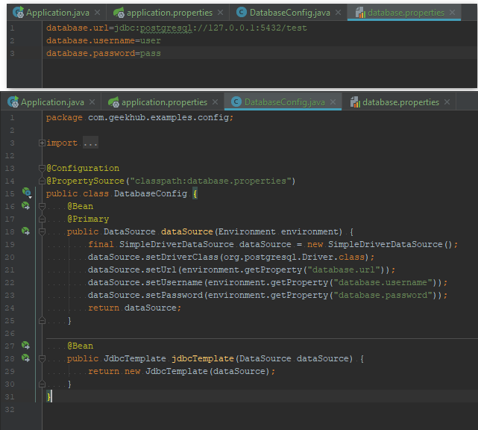
Spring JdbcTemplate. Initialization
JDBCTemplate
DataSource
DB

Slide 6
Spring JdbcTemplate. Who does what?
Action | Spring | You
Define connection parameters. |  | X
Open the connection. | X
Specify the SQL statement. |  | X
Declare parameters and provide parameter values |  | X
Prepare and execute the statement. | X
Set up the loop to iterate through the results (if any). | X
Do the work for each iteration. |  | X
Process any exception. | X
Handle transactions. | X
Close the connection, statement and resultset. | X

Slide 7
Spring JdbcTemplate. Most Used Methods
void execute(String sql, Object... args); void query(String sql, RowCallbackHandler rch, Object... args); <T> List<T> query(String sql, RowMapper<T> rowMapper, Object... args); <T> T queryForObject(String sql, RowMapper<T> rowMapper, Object... args); <T> T queryForObject(String sql, Class<T> requiredType, Object... args); <T> List<T> queryForList(String sql, Class<T> elementType, Object... args); int update(String sql, Object... args); int[] batchUpdate(String... sql); int[] batchUpdate(String sql, List<Object[]> batchArgs);

Slide 8
Spring JdbcTemplate. ResultSet
boolean next() throws SQLException; void close() throws SQLException;
boolean wasNull() throws SQLException;
String get**SomeType(int columnIndex) throws SQLException;
String get**SomeType(String columnLabel) throws SQLException;
Object getObject(String columnLabel) throws SQLException;
<T> T getObject(String columnLabel, Class<T> type) throws SQLException;
java.sql.Date getDate(int columnIndex) throws SQLException;
java.sql.Timestamp getTimestamp(int columnIndex) throws SQLException;
java.sql.Time getTime(int columnIndex) throws SQLException;

Slide 9
Spring JdbcTemplate. RowMapper
The interface of processing a single line of query results and turning it into an object
public interface RowMapper<T> { T mapRow(ResultSet rs, int rowNum) throws SQLException; }
public User findBy(Integer id) { return jdbcTemplate.queryForObject( "SELECT first_name, last_name FROM users WHERE id = ?", (rs, rowNum) -> { User actor1 = new User(); actor1.setFirstName(rs.getString("first_name")); actor1.setLastName(rs.getString("last_name")); return actor1; }); }

Slide 10
Spring JdbcTemplate. BeanPropertyRowMapper
public User findByBPRM(Integer id) { return jdbcTemplate.queryForObject( "SELECT firstName, lastName FROM users WHERE id = ?", new BeanPropertyRowMapper<>(User.class) ); }

Slide 11
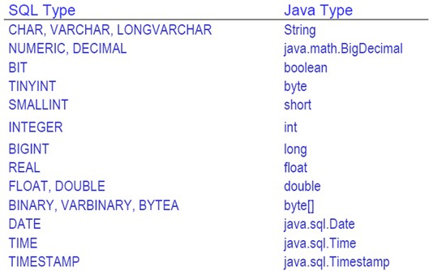
Mapping Java Types to SQL Types

Slide 12
Spring JdbcTemplate. SQL Injections
JdbcTemplate supports ? wildcard (the same as PreparedStatement)
Use this wildcard in everywhere where its possible
It provides few benefits:
Prevents SQL Injections
Allows databases to create execution plan for your query
Makes SQL more readable inside the Java code
Create SQL queries by concatenation only if this is a only way to do this
Escape parameters that concatenated to SQL to avoid SQL Injections (better to use util methods from external libs)

Slide 13
Literature
Accessing Relational Data using JDBC with Spring
Spring Jdbc
Spring Jdbc tutorial
Spring JdbcTemplate tutorial

Slide 14
Homework 1
Use Spring Boot to create WEB application from Lecture 15
Use database as storage for all data
Use NamedParamJdbcTemplate to select/insert/update/delete all required data from/into database
Use each of next methods in your app:
void query(String sql, RowCallbackHandler rch, Object... args);
<T> List<T> query(String sql, RowMapper<T> rowMapper, Object... args);
<T> T queryForObject(String sql, RowMapper<T> rowMapper, Object... args);
<T> T queryForObject(String sql, Class<T> requiredType, Object... args);
<T> List<T> queryForList(String sql, Class<T> elementType, Object... args);
int update(String sql, Object... args);
int[] batchUpdate(String sql, List<Object[]> batchArgs);

